Slide 1




BUILDING MARVEL HEROES CLASSIFIER
USING CNN
JAY SANKPAL
ATHARV SHINGEWAR
~By CSI DMCE

Slide 2




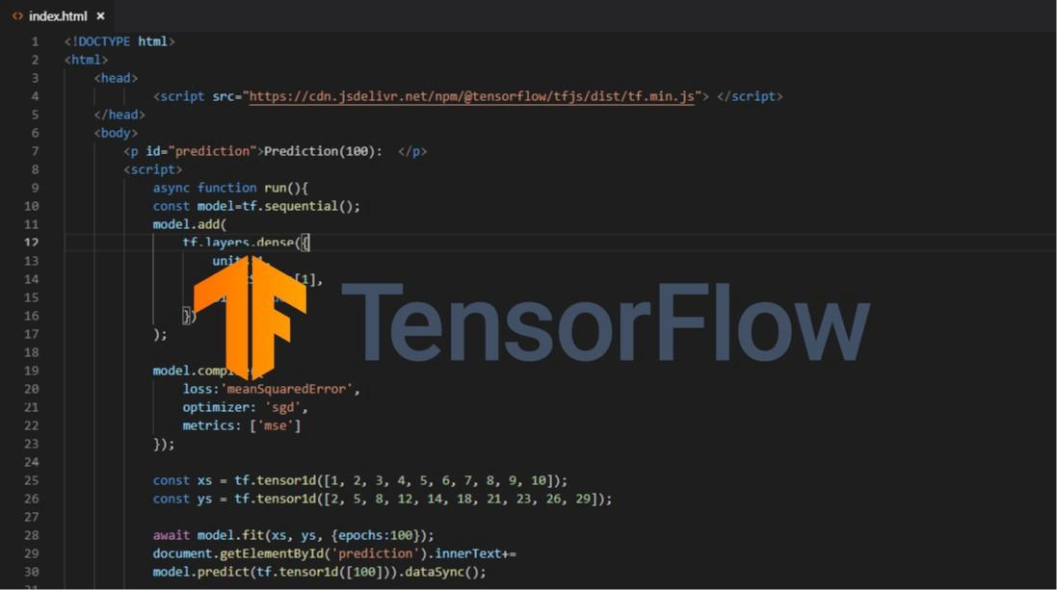
RESOURCES/TECHNOLOGIES
Here are the resources which we will get to see in this workshop:
Google Collaboratory
Kaggle
GitHub
Data world
TensorFlow

Slide 3
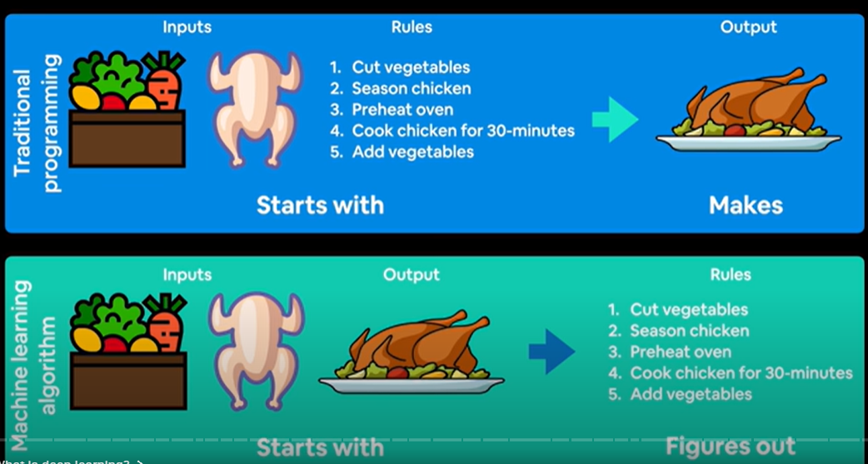
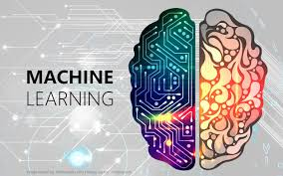
What is Machine Learning?
MACHINE LEARNING IS TURNING THINGS (DATA) INTO NUMBERS AND FINDING PATTERNS IN THOSE NUMBERS.

Slide 4
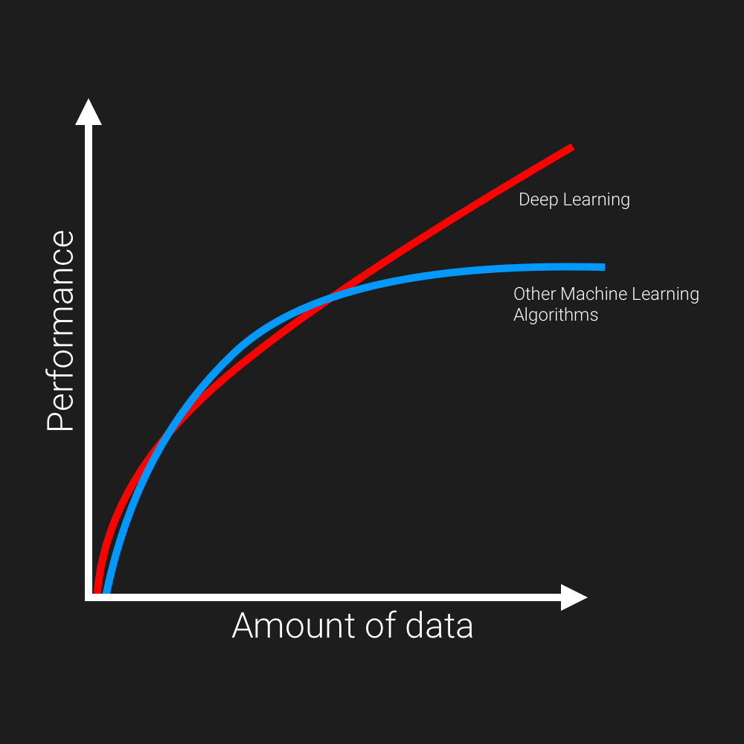
What is Deep Learning?
Deep learning refers to training the neural networks and sometimes very large neural networks.
Deep learning algorithms can learn very complex patterns, if provided enough data.

Slide 5
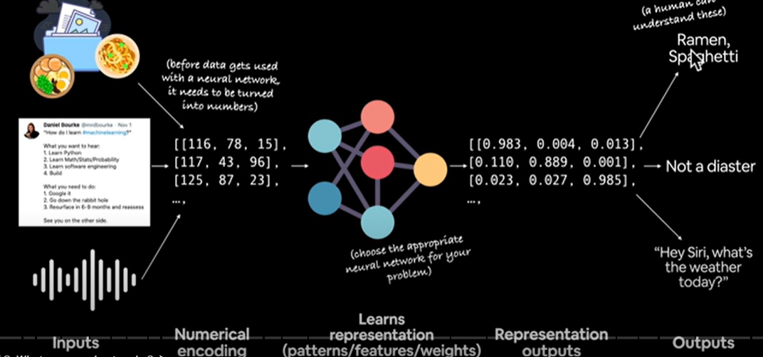
Neural Networks

Slide 6

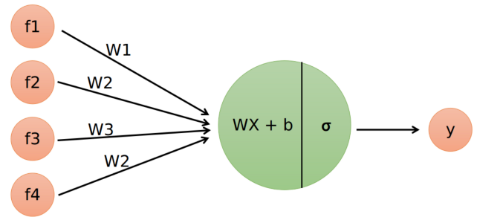
BASIC TERMINOLOGIES OF NNs
STRUCTURE OF A SIMPLE NEURAL NETWORK
WHAT REALLY HAPPENS INSIDE A NEURON ?
OVERFITTING

Slide 7
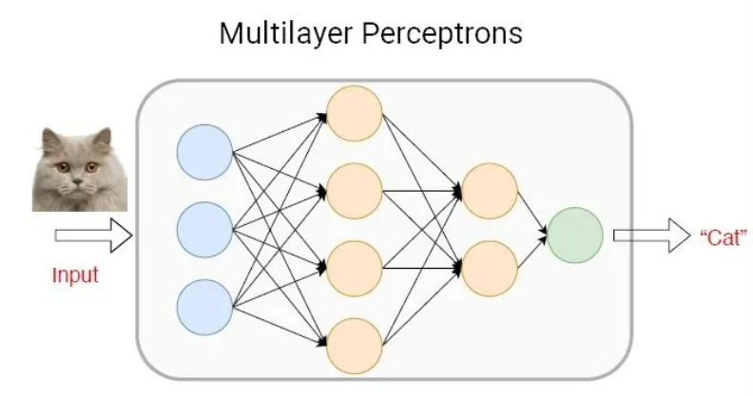
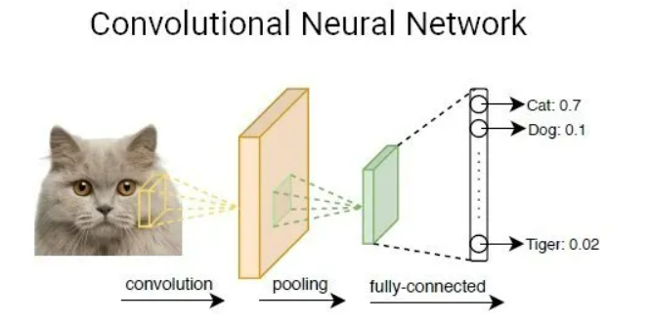
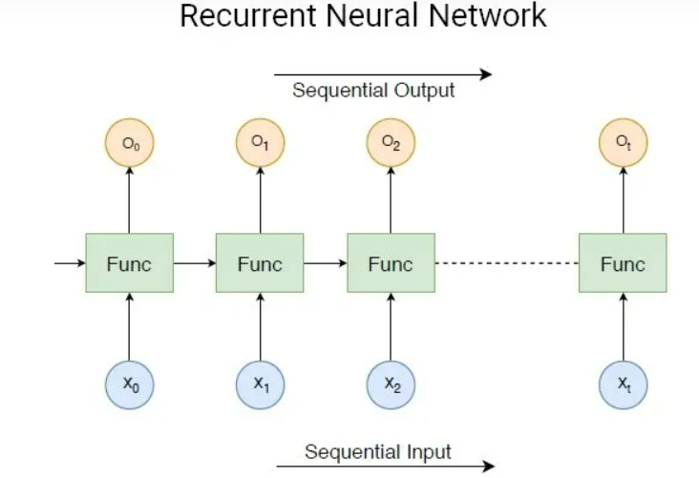
Types of Neural Networks
MLP
CNN
RNN
A recurrent neural network (RNN) is another class of artificial neural networks that use sequential data feeding. RNNs have been developed to address the time-series problem of sequential input data.
A multilayer perceptron (MLP) is a class of a feedforward artificial neural network (ANN). MLPs models are the most basic deep neural network, which is composed of a series of fully connected layers.
A convolutional neural network (CNN, or ConvNet) is another class of deep neural networks. CNNs are most commonly employed in computer vision

Slide 8
Deep Learning Frameworks
Pytorch
Matlab
PyTorch is a Python package that provides two high-level features:
Tensor computation (like numpy) with strong GPU acceleration.
Deep Neural Networks (DNN) built on a tape-based autograd system.
MATLAB makes DL easy for engineers, scientists, and domain experts. With tools and functions for managing and labeling large data sets, MATLAB also offers specialized toolboxes for working with machine learning, neural networks, computer vision, and automated driving.
Tensorflow
PaddlePaddle
TensorFlow is an open source software library for numerical computation using data flow graphs. Nodes in the graph represent mathematical operations, while the graph edges represent the multidimensional data arrays (tensors) that flow between them.
PaddlePaddle provides an intuitive and flexible interface for loading data and specifying model structures. It supports CNN, RNN and multiple variants, and easily configures complicated deep models.

Slide 9
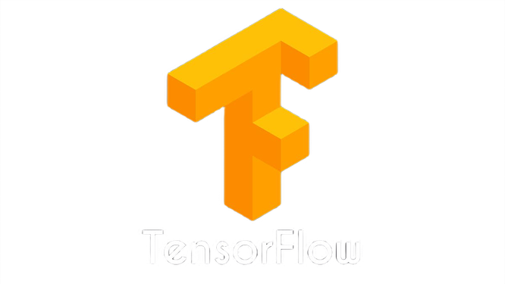
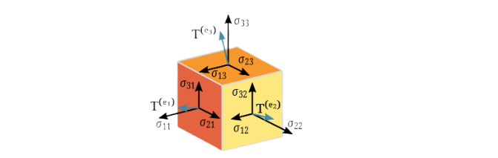

What is TensorFlow and what are tensors?
TensorFlow is an end-to-end open source platform for machine learning. It has a comprehensive, flexible ecosystem of tools, libraries and community resources that lets researchers push the state-of-the-art in ML and developers easily build and deploy ML powered applications.
Tensors are simply mathematical objects that can be used to describe physical properties, just like scalars and vectors. In fact tensors are merely a generalization of scalars and vectors; a scalar is a zero rank tensor, and a vector is a first rank tensor.
Tensor

Slide 10
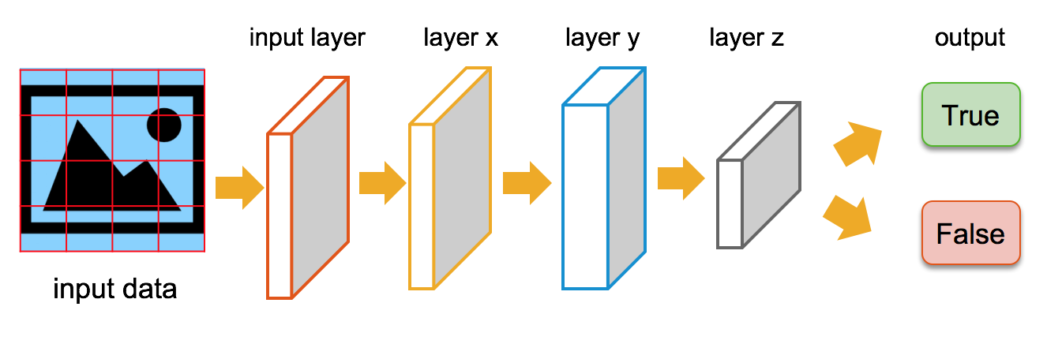
MODEL IN TENSORFLOW
In machine learning, a model is a function with learnable parameters that maps an input to an output. The optimal parameters are obtained by training the model on data. A well-trained model will provide an accurate mapping from the input to the desired output.Most models are made of layers.
There are two ways to create models in Tensorflow:-
Sequential model
Functional API

Slide 11
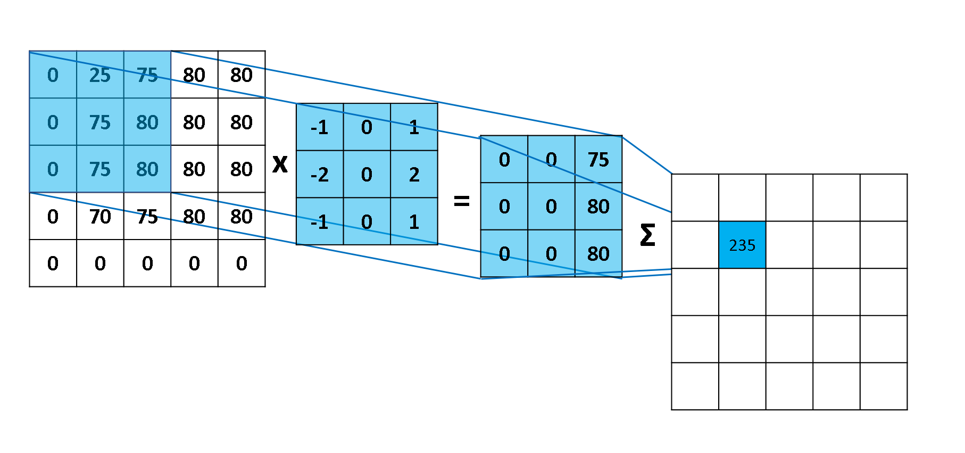
What is Convolution operation?
filter/kernel
Input
Resultant Output

Slide 12
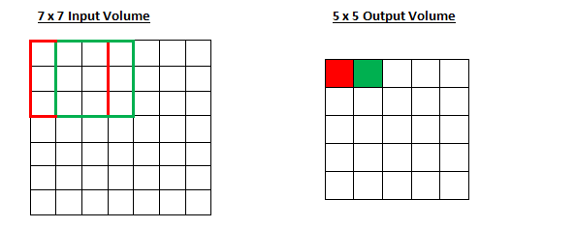
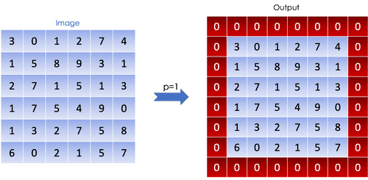
Stride
Padding

Slide 13
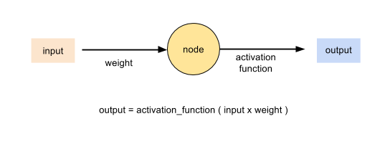
Activation Function
An activation function in a neural network defines how the weighted sum of the input is transformed into an output from anode or nodes in a layer of the network.

Slide 14

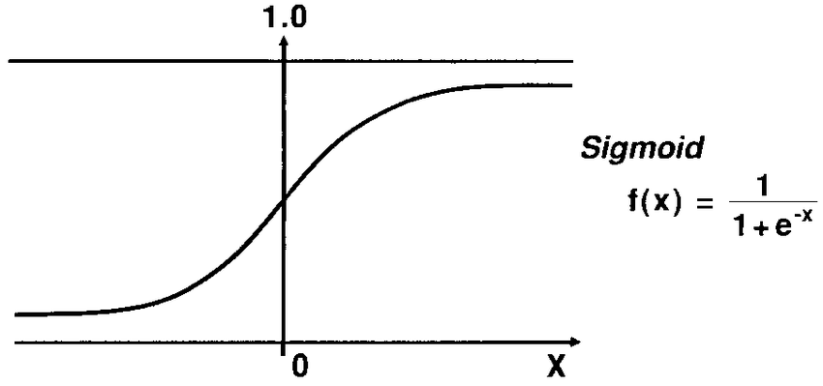
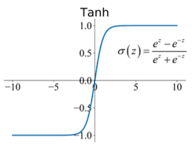
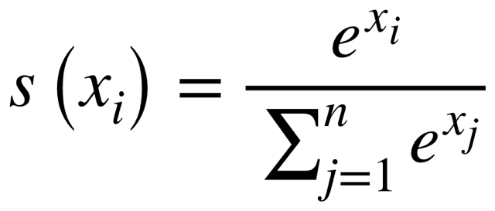
SOME ACTIVATION FUNCTIONS
01
SIGMOID
02
RELU
02
03
SOFTMAX
TANH
04

Slide 15
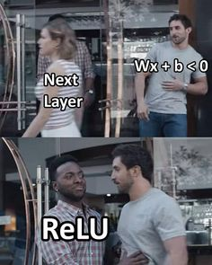
still have any doubts about ReLu?

Slide 16
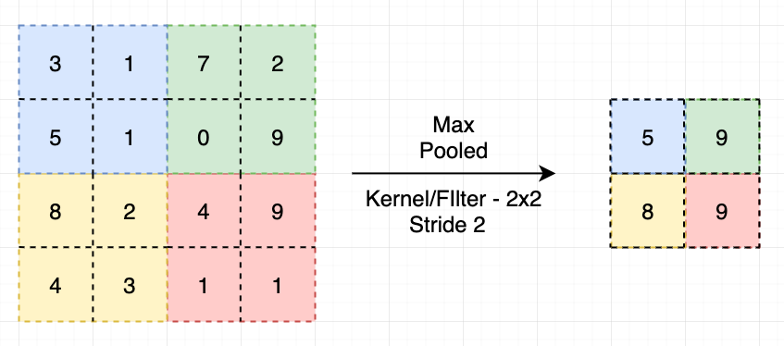
Max Pooling Layer

Slide 17
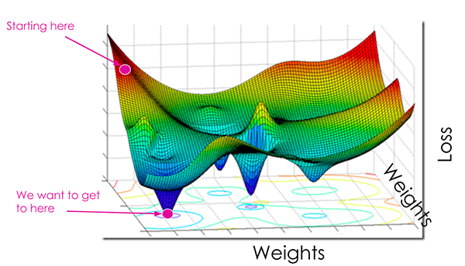
LOSS
LOSS
The Loss Function is one of the important components of Neural Networks. Loss is nothing but a prediction error of Neural Net. And the method to calculate the loss is called Loss Function. In simple words, the Loss is used to calculate the gradients. And gradients are used to update the weights of the Neural Net.

Slide 18
LOSS
SOME LOSS FUNCTIONS
Mean Squared Error
Mean Absolute Error
Binary Cross Entropy
Categorical Cross Entropy

Slide 19
OPTIMIZER
OPTIMIZER
An optimizer is a function or an algorithm that modifies the attributes of the neural network, such as weights and learning rate. Thus, it helps in reducing the overall loss and improve the accuracy.

Slide 20
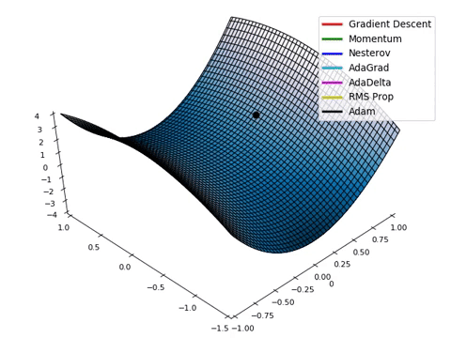
OPTIMIZER
SOME COMMON OPTIMIZER
FUNCTIONS
SGD
RMS PROP
ADAM

Slide 21

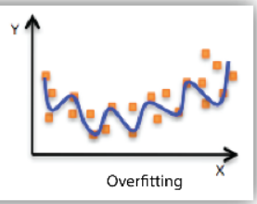
OVERFITTING
OVERFITTING
Good performance on the training data, poor generalization to other data.

Slide 22
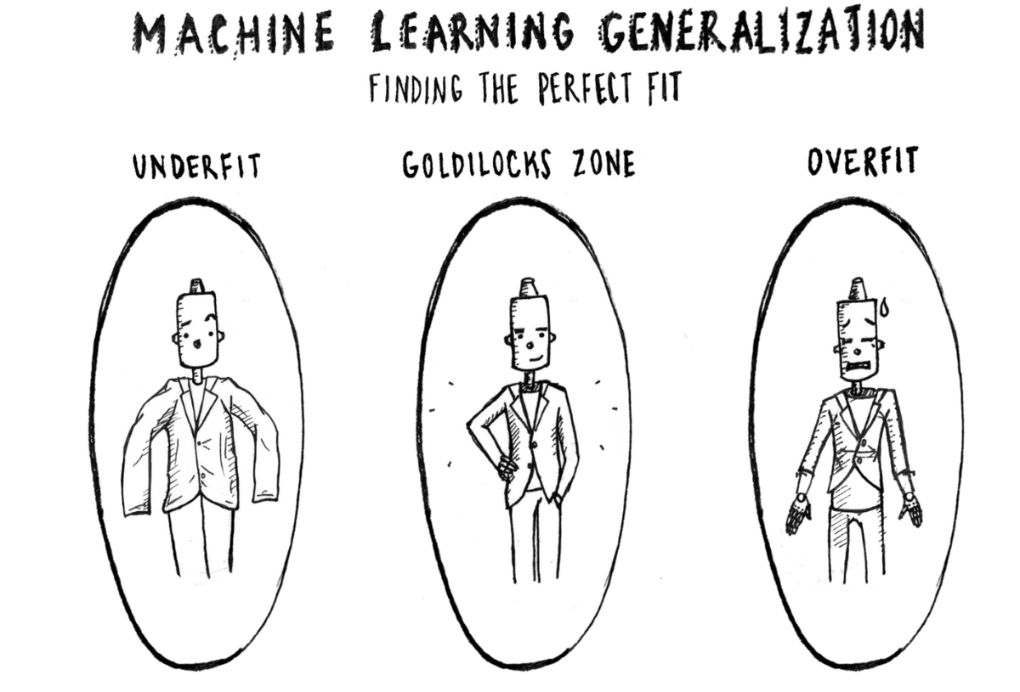
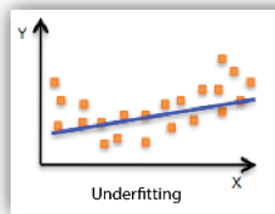
UNDERFITTING
UNDERFITTING
Poor performance on the training data and poor generalization to other data.

Slide 23
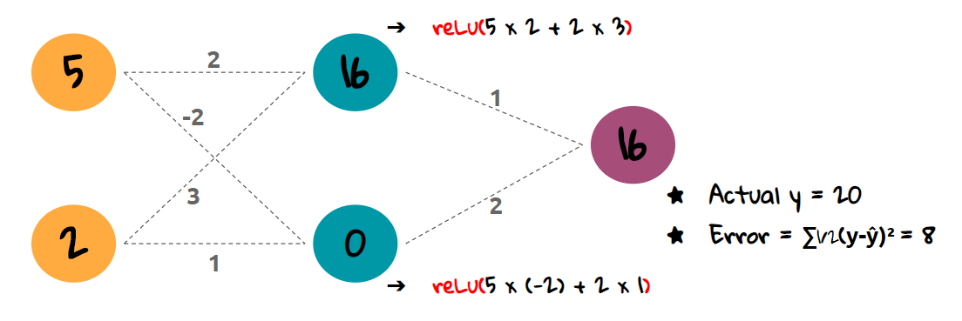
wHAT ARE WEIGHTS ?
WEIGHTS
Weights are values that control the strength of the connection between two neurons. That is, inputs are typically multiplied by weights, and that defines how much influence the input will have on the output. In other words: when the inputs are transmitted between neurons, the weights are applied to the inputs along with an additional value (the bias).

Slide 24
CHECKPOINTS
CHECKPOINTS
It is an approach where a snapshot of the state of the system is taken in case of system failure. If there is a problem, not all is lost. The checkpoint may be used directly, or used as the starting point for a new run, picking up where it left off.

Slide 25
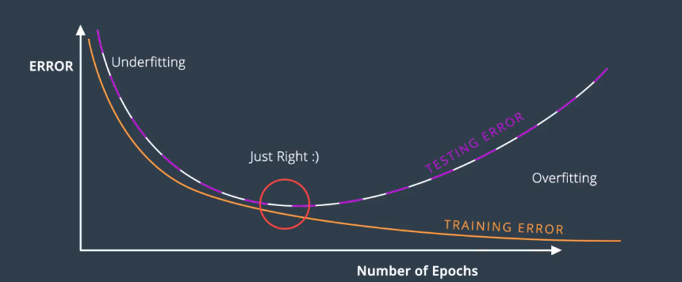
WHAT IS AN EPOCH ?
An epoch is a term used in machine learning and indicates the number of passes of the entire training dataset the machine learning algorithm has completed. Datasets are usually grouped into batches (especially when the amount of data is very large).

Slide 26
DEPLOYMENT

Slide 27

THANK YOU!!

